Slide 1
An. quadrimaculatus genome assembly

Slide 2
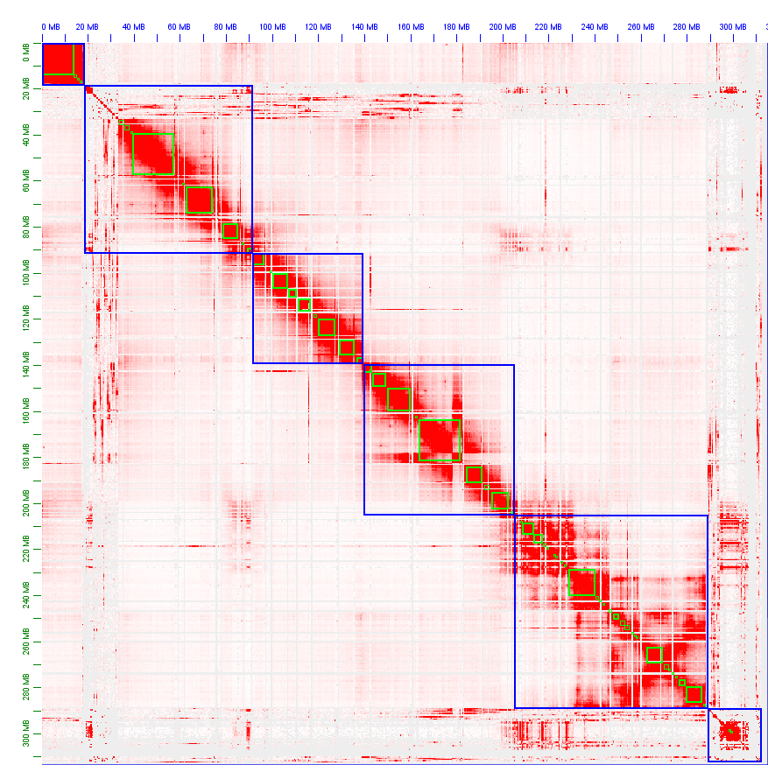
Raw assembly
X
2R
2L
3R
Contig missjoin
3L

Slide 3
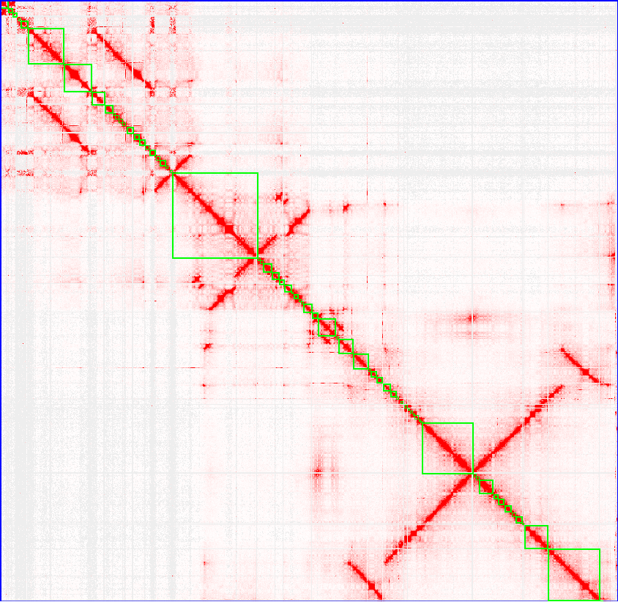
3L chromosome
Evidence of global 3L chromosome
“duplications”

Slide 4
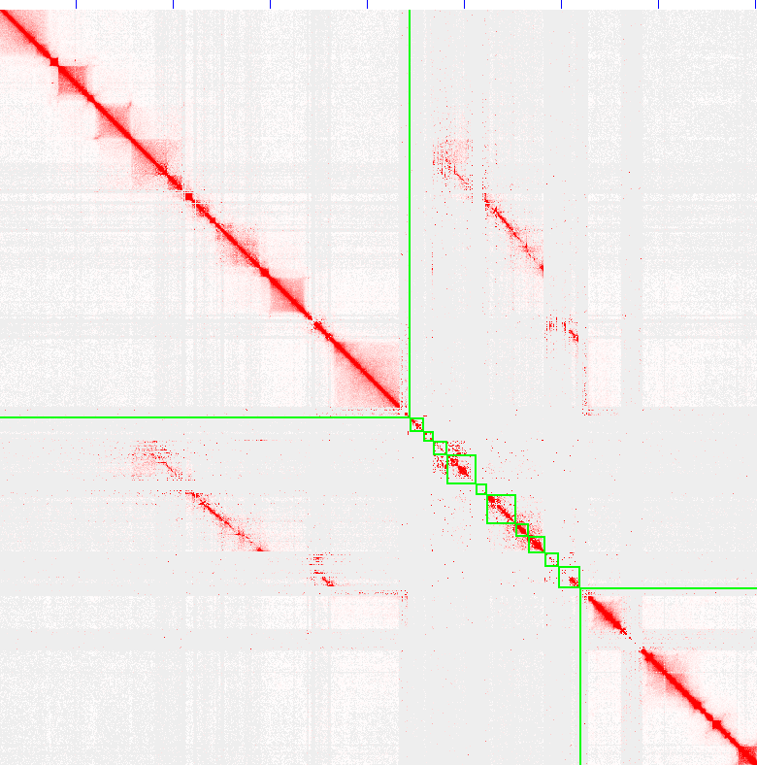
3R chromosome
Repeats and putative population variants

Slide 5
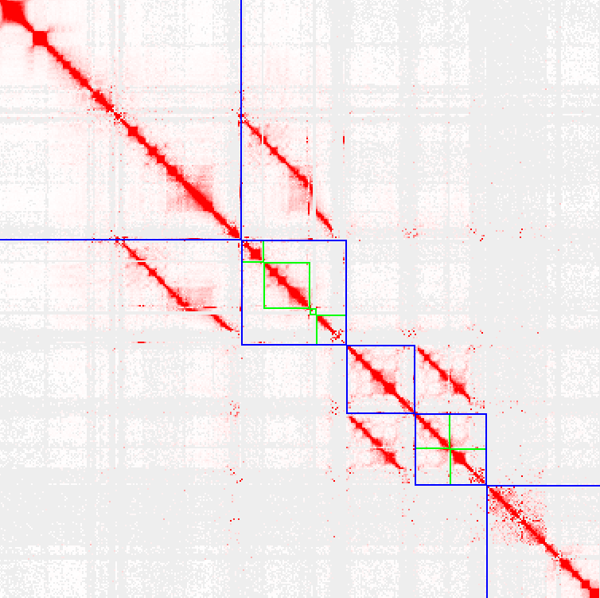
3R
Putative 3R-3L boudary
3Ra1
3Ra2
3Rb1
3Rb2
3L1

Slide 6
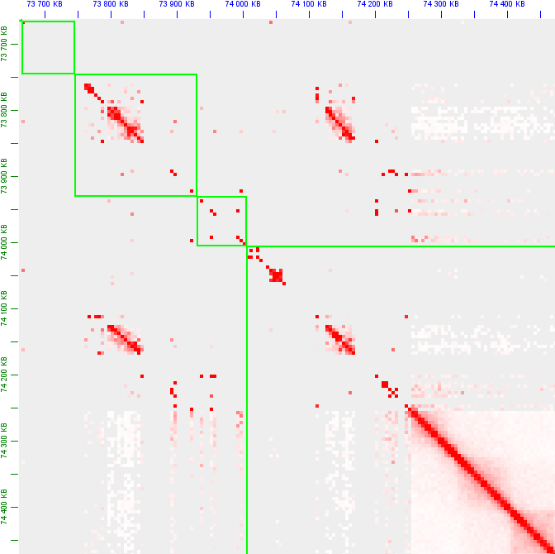
Repeats and variants
tig00000281 71229 55691
tig00075149 0 55694
tig00000281 127152 10260
tig00075149 55926 10269
tig00000281 137405 43667
tig00075149 72321 43723
tig00000281 187011 69704
tig00075149 116028 69699
tig00000113 9918506 6219 (2R)
tig00075149 66116 6205
tig00000049 1194307 6268 (X)
tig00075149 66192 6129

Slide 7
Repeats and variants
tig00000281 71229 55691
tig00075149 0 55694
tig00000281 127152 10260
tig00075149 55926 10269
tig00000281 137405 43667
tig00075149 72321 43723
tig00000281 187011 69704
tig00075149 116028 69699
tig00000113 9918506 6219 (2R)
tig00075149 66116 6205
tig00000049 1194307 6268 (X)
tig00075149 66192 6129

Slide 8
Repeats and variants
tig00000281 175968 5104
tig00075150 0 5094
tig00000281 187016 70189
tig00075150 5083 70166
tig00000281 200838 3262
tig00075150 15696 3215
tig00000281 197625 3216
tig00075150 18908 3256

Slide 9
Repeats and variants
tig00000281 175968 5104
tig00075150 0 5094
tig00000281 187016 70189
tig00075150 5083 70166
tig00000281 200838 3262
tig00075150 15696 3215
tig00000281 197625 3216
tig00075150 18908 3256

Slide 10
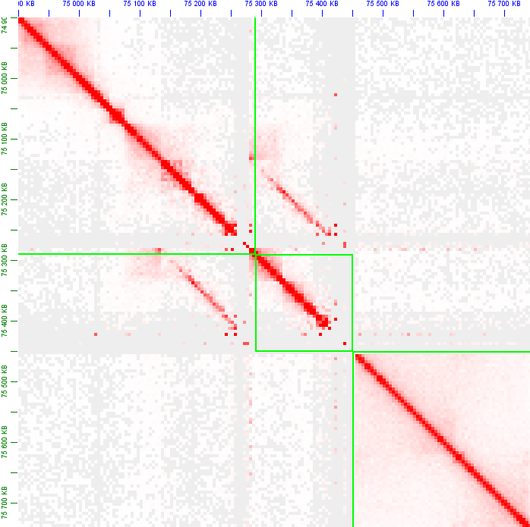
Full contig repeats
tig00000281 1396495 51818
tig00075237 0 52306
tig00000281 1448305 3873
tig00075237 52732 3895
tig00000281 1452173 5999
tig00075237 57035 6026
tig00000281 1458714 41394
tig00075237 63051 41560
tig00000281 1500084 54838
tig00075237 107903 54756

Slide 11
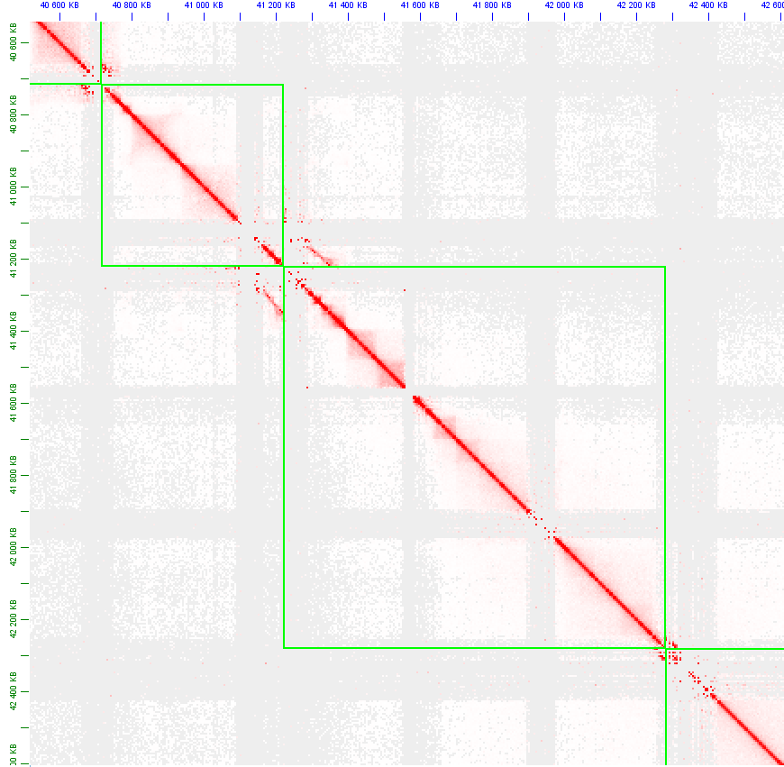
Repeats saving
Repeats on contig
boundaries are saved for the final assembly

Slide 12
Assembly of 3R/3L chromosome
1
2
3
4
5
6
7
8
contig 1 bans contigs 4,5,6
contig 2 bans contigs 6
contig 3 bans contigs 7,8
colocalization:
1+2, 4+5+6, 3, 7+8
misunderstooding:
1+2 vs. 3, 1+2 vs 7+8 ...

Slide 13
3R
3Ra1
3R = 54,129,534
3Ra1 = 1,917,789
3Ra2 = 1,652,444
3Rb1 = 1,086,300
3Rb2 = 1,127,397
3Ra2
3Rb1
3Rb2
3L1

Slide 14
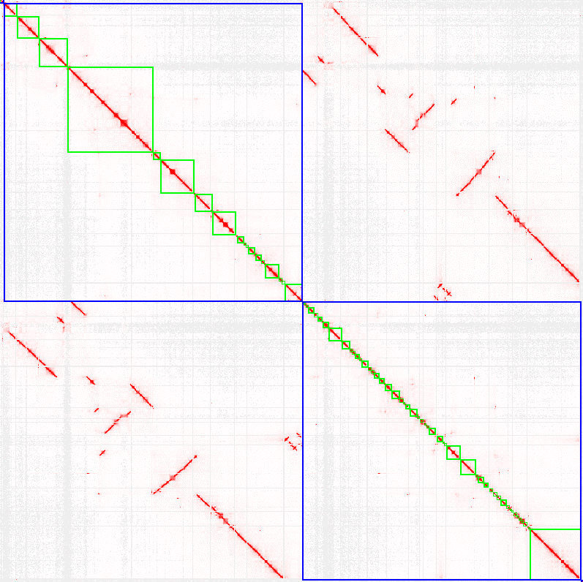
3L1
3L1 = 40,799,416
3L2 = 38,102,457
3L2

Slide 15
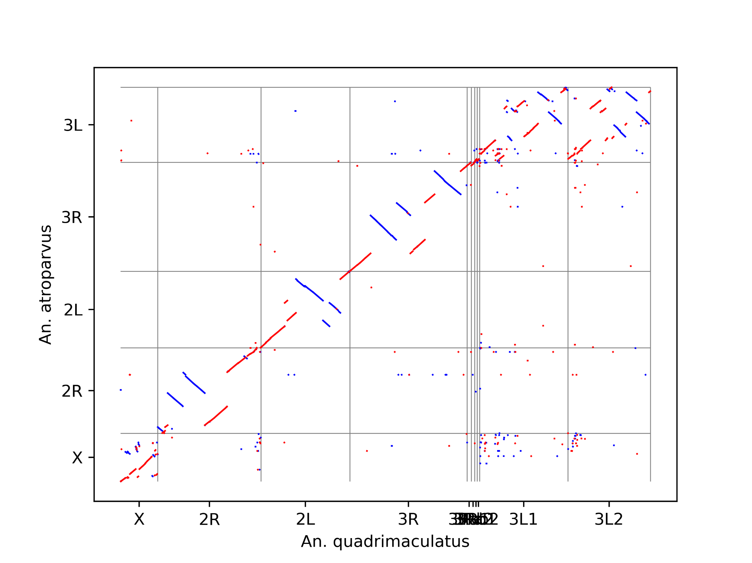
An.quadrimaculatus vs An.atropravus
3Lb1 and 3Lb2 scaffold of An.qaudrimaculatus are syntenic for 3L chromosome An.atroparvus

Slide 16
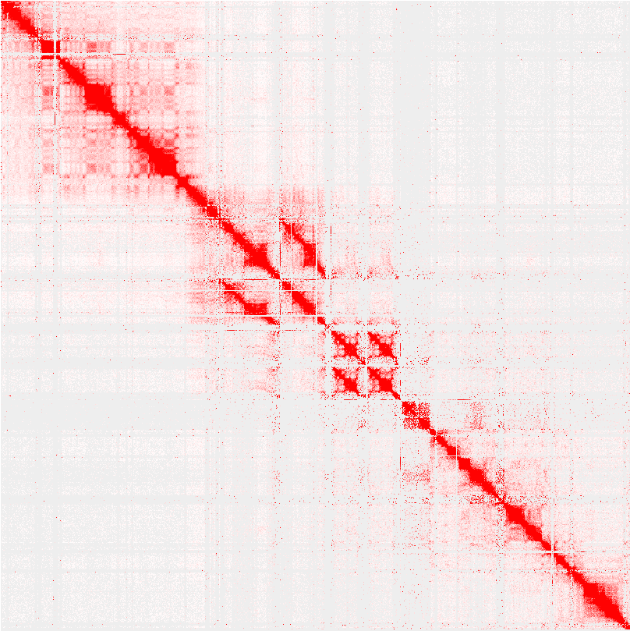
3Ri
3Ra1
3Rb1
3Ra2
3Rb2
3L

Slide 17
An. freeborni genome assembly

Slide 18
Hi-C statistic
Sequenced Read Pairs | 150,329,898
Normal Paired | 99,377,569 (66.11%)
Chimeric Paired | 36,247,972 (24.11%)
Chimeric Ambiguous | 11,499,506 (7.65%)
Unmapped | 3,204,851 (2.13%)
Alignable | 135,625,541 (90.22%)
PCR Duplicates | 23,946,590 (17.65%)
Optical Duplicates | 1,265,970 (0.93%)
Unique Reads | 110,412,981 (81.41%)
Intra-fragment Reads | 3,590,714 (3.25%)
Below MAPQ Threshold | 19,681,244 (17.83%)
Hi-C Contacts | 87,141,023 (78.92%)

Slide 19
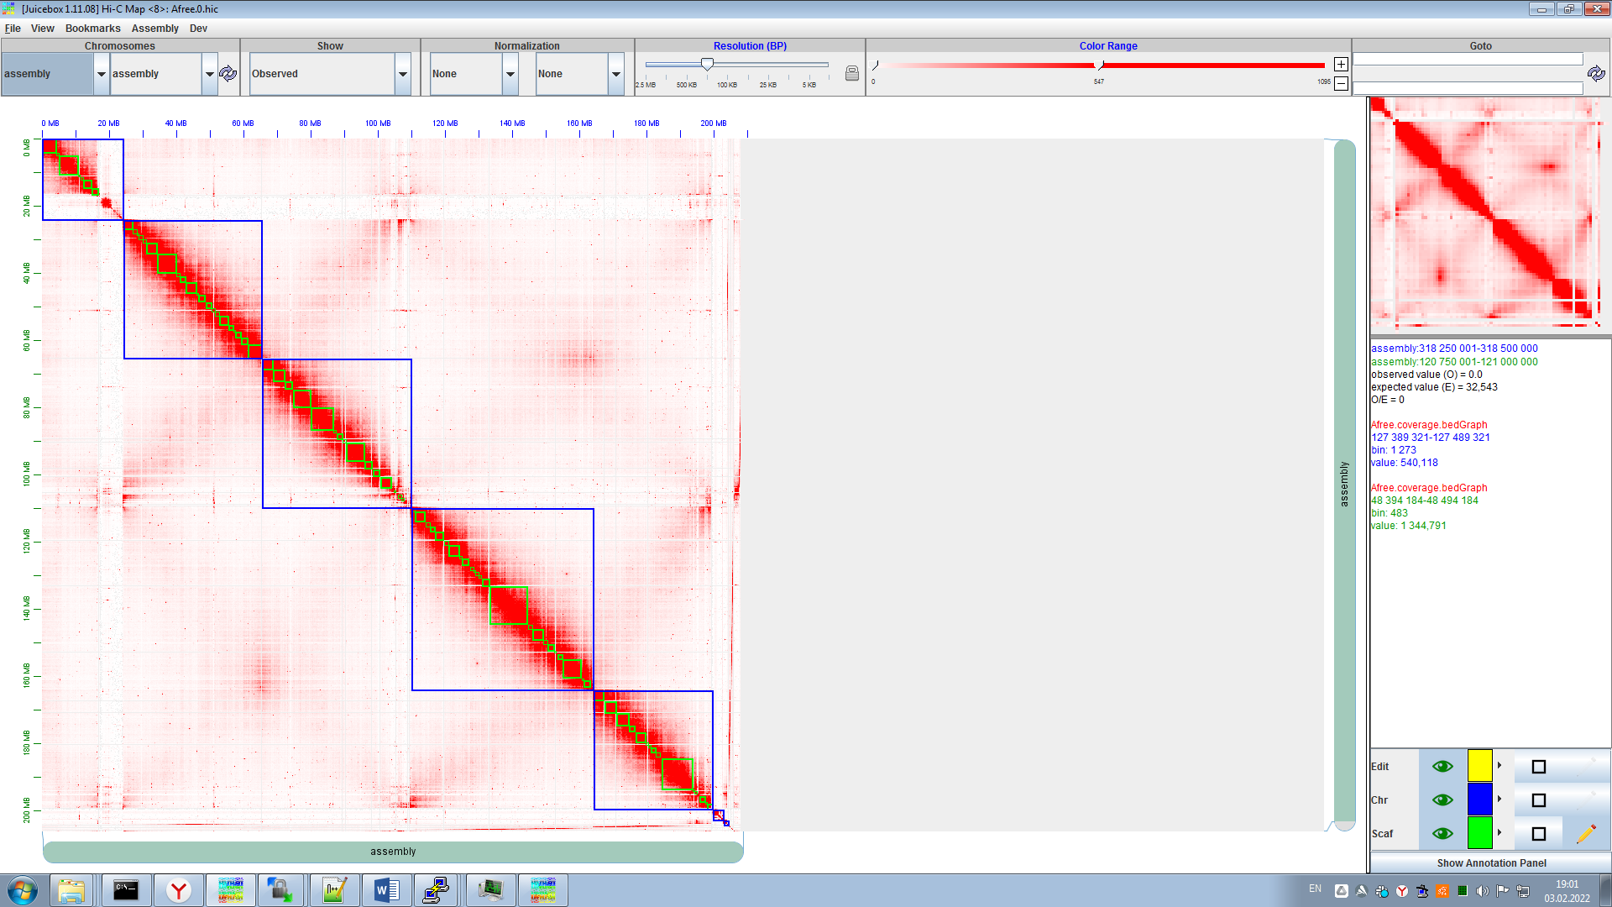
Rabl-configuration

Slide 20
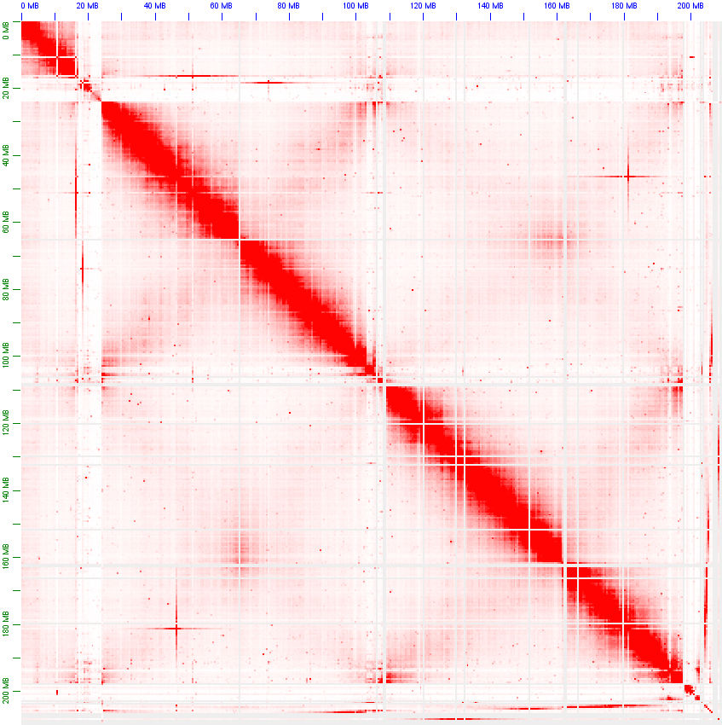
An.freeborni
Full contig length: ~209 Mb
Ordered: ~193Mb
Putative X-heterochomatine: ~6Mb
Unplacement contigs: ~4Mb
Resolved polymorphismes: ~6Mb

Slide 21
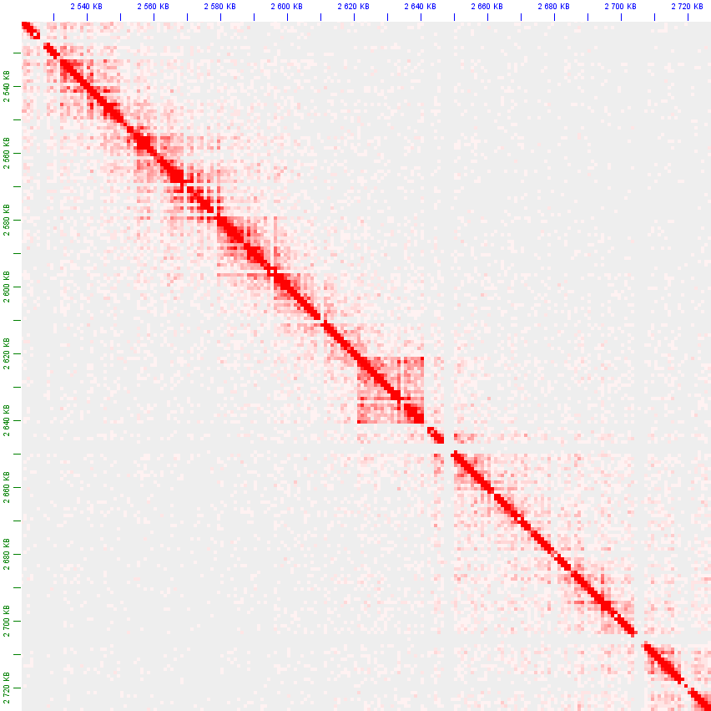
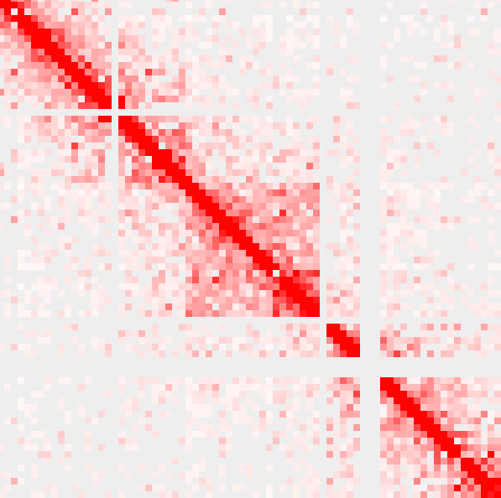
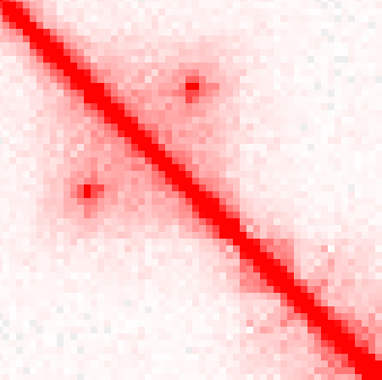
An.freeborni: putative tandem duplication
X

Slide 22
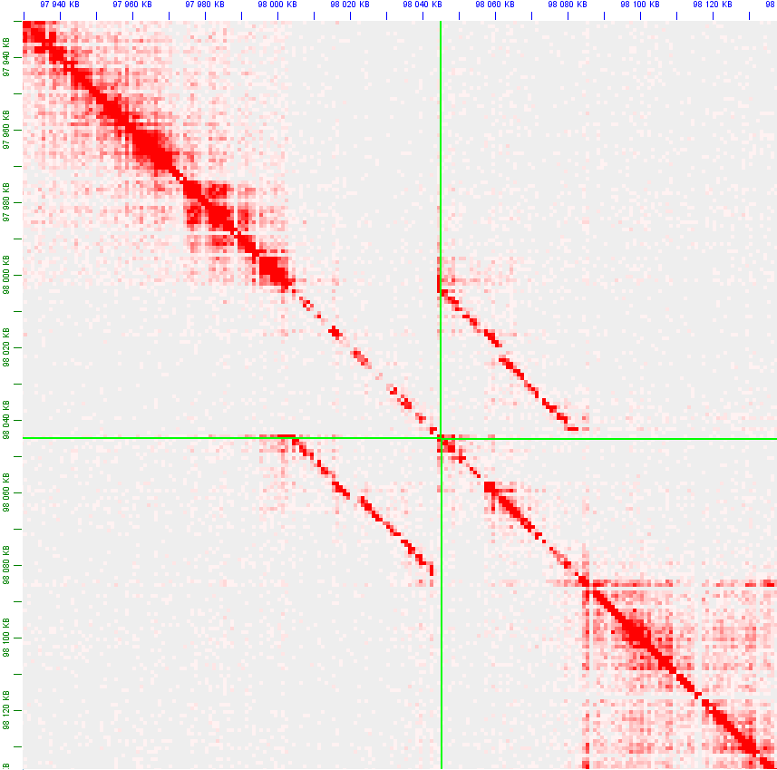
An.freeborni: scaffold joins

Slide 23
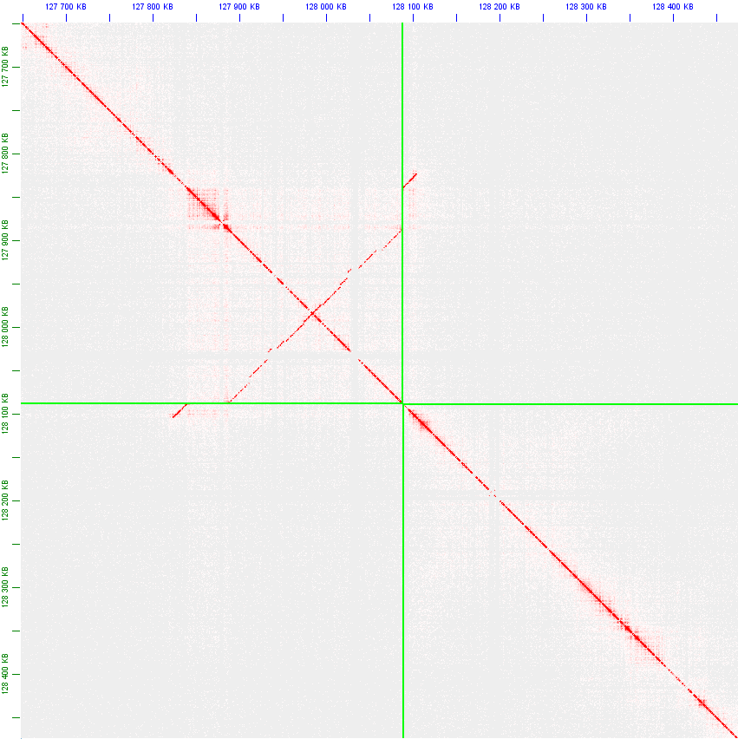
An.freeborni: 3R

Slide 24
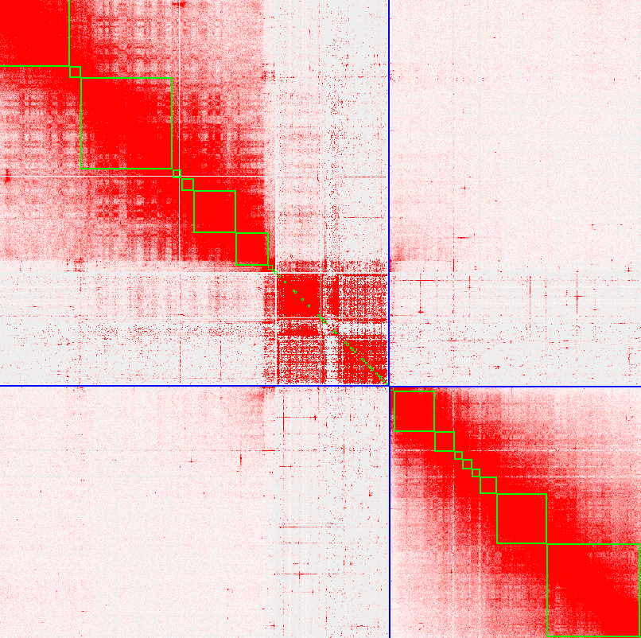
An.freeborni: X-heterochromatine
X
2R

Slide 25
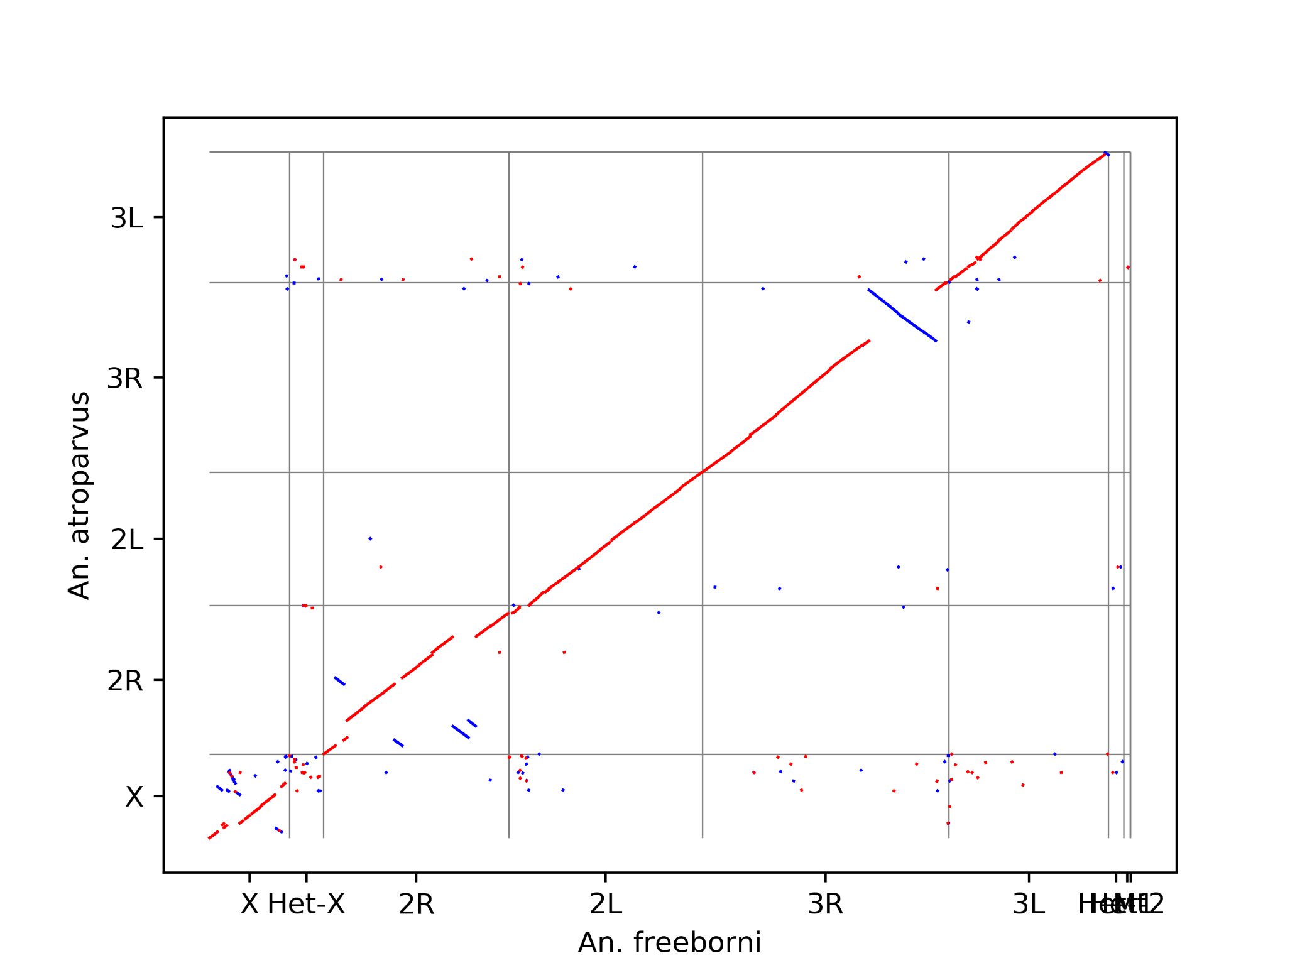
An.freeborn – An. atroparvus alignment

Slide 26
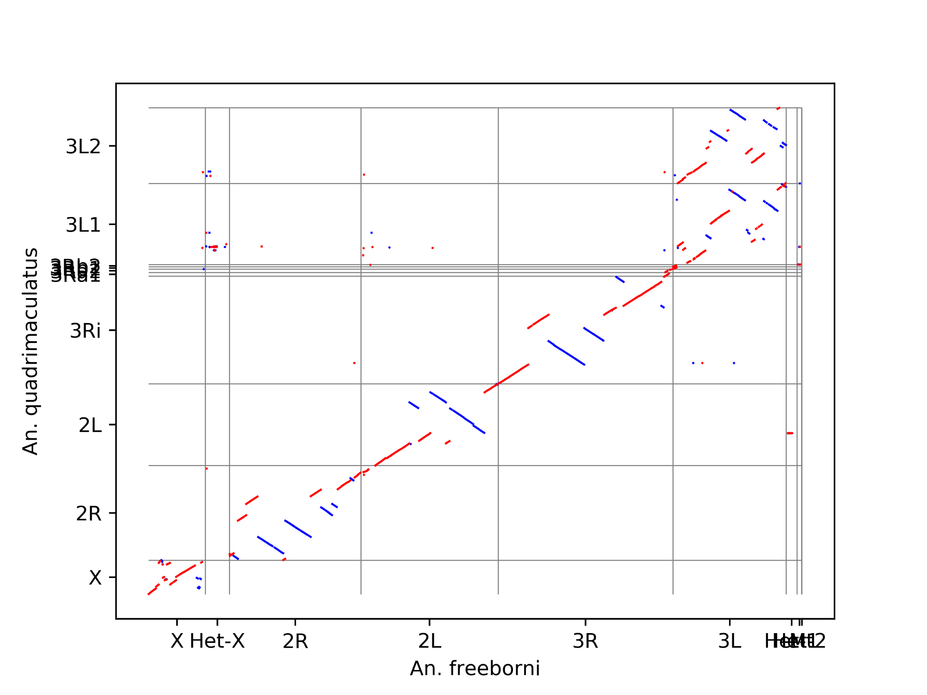
An.freeborn – An. quadrimaculatus alignment

